Slide 1
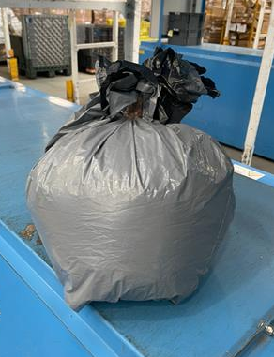
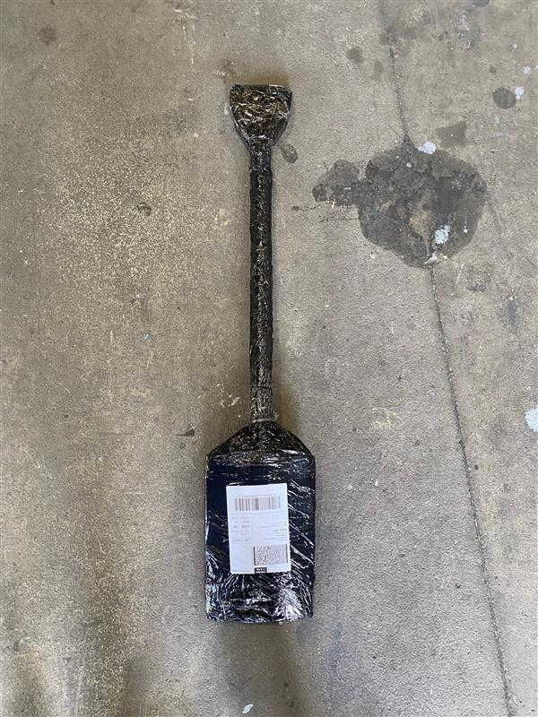
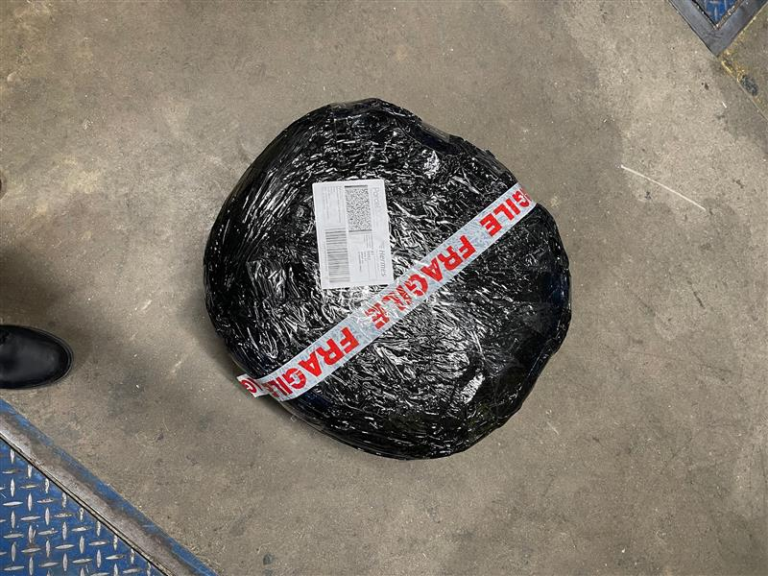
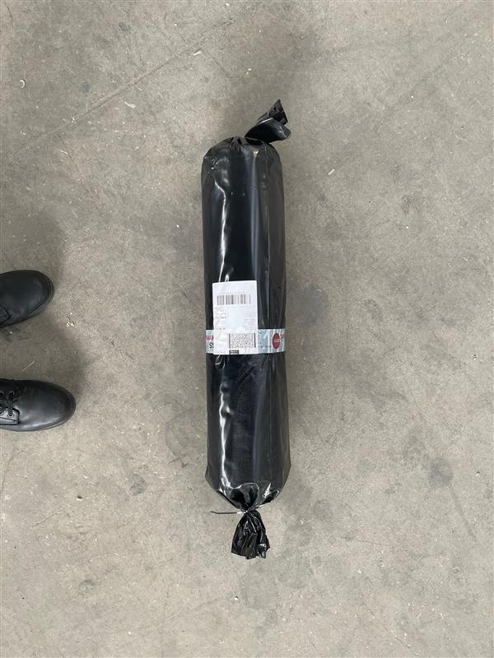
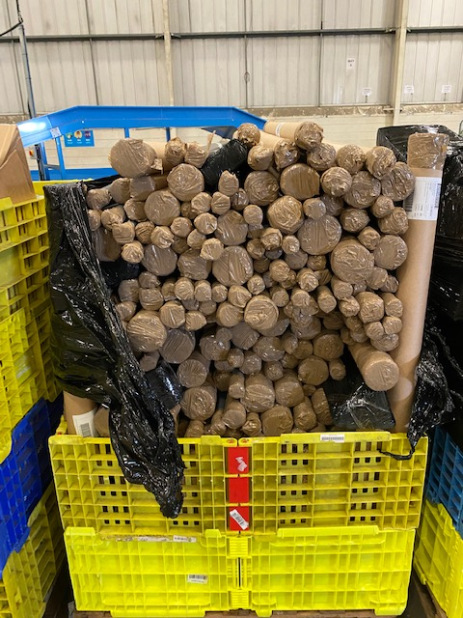
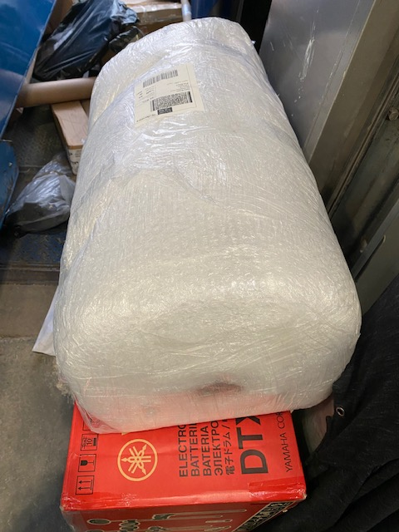
ManuAL TRAFFIC
Odd shapes & large/heavy parcels are handled manually
Parcels that are large, round/ circular, have no flat surface or have odd edges, should be loaded together where possible
These will be manually handled at our Hubs to reduce sorter no-reads, blockages and damage to automated sorters
For example – large furniture, carpets, pillows, gardening utensils, bamboo canes, etc

Slide 2
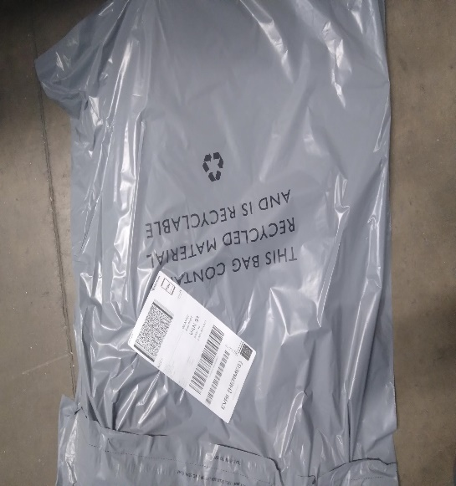
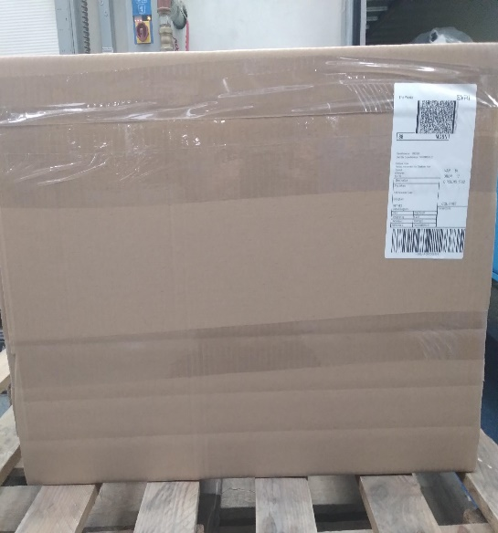
Packaging
Securing packaging using tape and pack materials
Quality
Bags should not have excess packaging.
Boxes should be secured on the seams with little empty air space inside – or space inside filled with packing material.
Barcode should not be taped over
Sufficient tape on all boxed seams

Slide 3
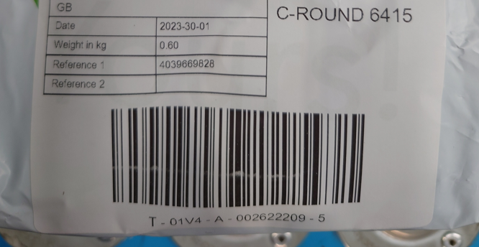
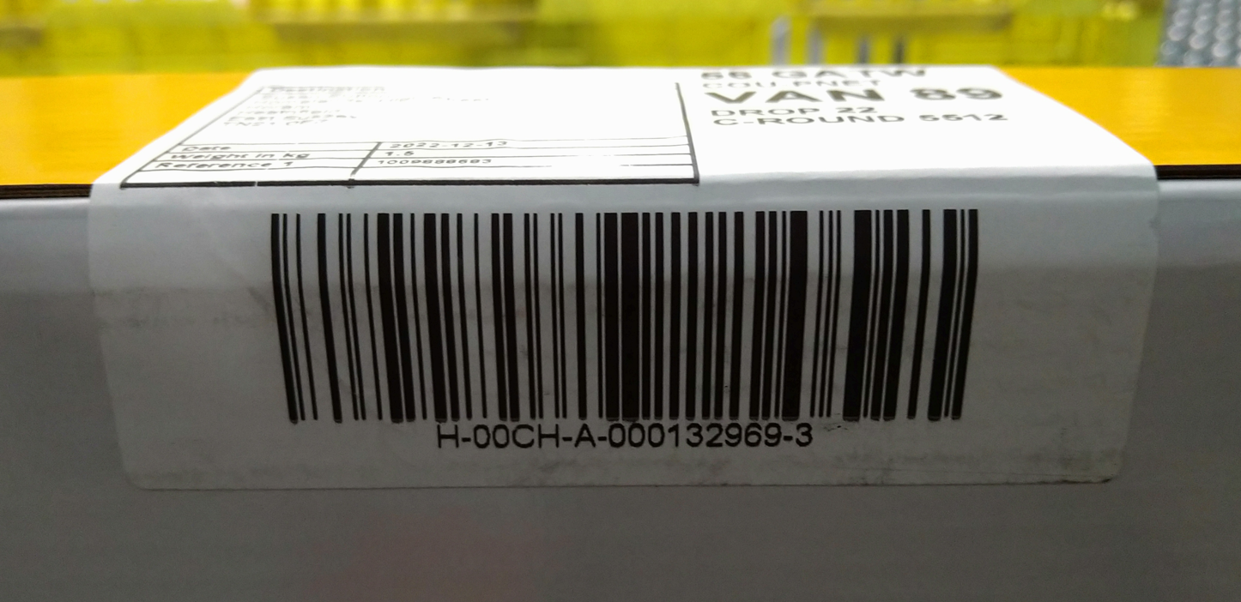
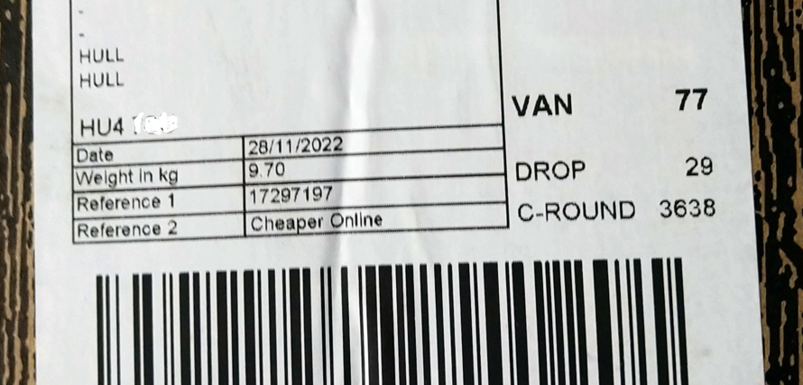
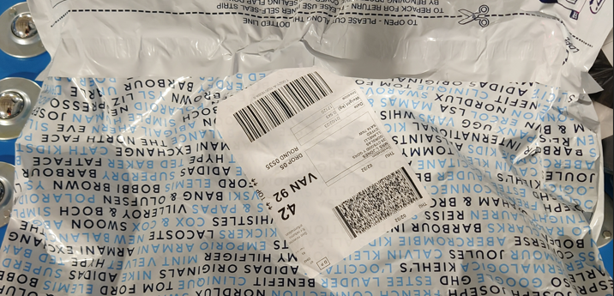
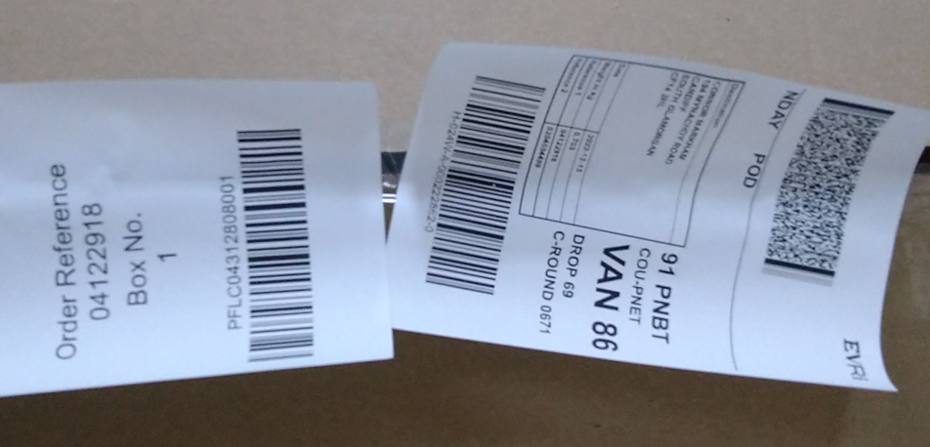
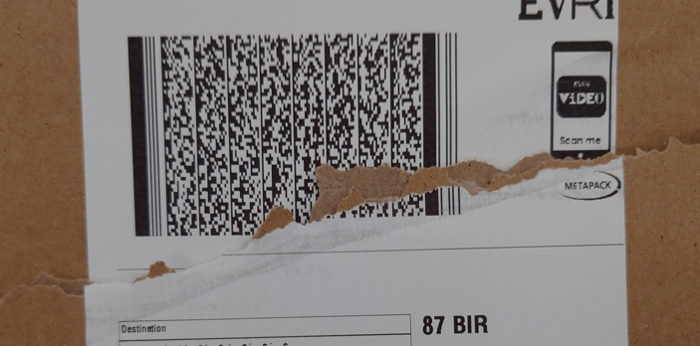
Label
Quality
White lines through the barcode
Poor label affixing
Issues
Faded labels – not clear or have gaps in
barcodes
Torn, insufficiently adhered or incorrectly
placed labels
Labels with missing info – without customer
details, pre-advice routing information,
or barcodes numbers
Non-Evri labels – which are carrier misroutes
Creased barcode on the box
Excess packaging
Risks
Non-automatic scans can lead to
manual processing & re-labelling/service delays
Parcels can become Unidentified Freight
Labels can stick on to another parcel & could
cause potential misroute
Label peeling off
Label details torn or scratched off

